Slide 1

Computer Randomization Algorithms: Drug Development Pipeline
Natalie LePera, STA514 – West Chester University

Slide 2
Computerized Randomization in the Drug Development Pipeline
Metabolomics / Proteomics: Mass Spectrometry Plate Randomization
Converts biological samples into digital / data
Pre-Clinical studies (animal models) for identification of target protein/gene
Randomization reduces machine drift & batch effects
Double Blind Clinical Trials: Interactive Web Randomization Service (IWRS)
Randomizes patients into treatment / placebo group(s)
Uses stratification as pseudo matching between experimental groups (age, gender, diabetes, etc.)
Customizable to trial specifics
Notes:
GWAS = genome wide association studies

Slide 3
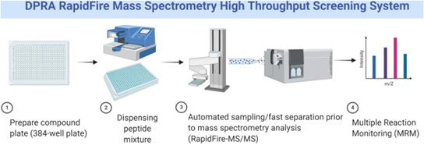
Mass Spectrometry (MS): Intro
Biological samples collected to assess proteins, metabolites, and/or nucleic acid content ⁴
Samples loaded into wells on plates for bulk analysis
Automated injection processes programmed by block randomization software ⁴
Commonly >350 wells per plate ³
Common Problems
Machine drift caused by contamination, temperature fluctuations, aging components, etc.
Signal can “drift” up to 25% in 12hrs ³
Samples often received by lab not in chronological order but collated
Requires documentation and traceability of all randomization ⁴
Figure 1: High throughput mass spectrometry process & plates ⁶

Slide 4
MS Randomization: Inter-Batch ⁴
EXAMPLE:
Goal: Randomizes injection order of samples into batches to reduce signal drift
Batches: usually full plates but can be mini squares within the plate depending on lab process
Stratified randomization utilized
Independent of any study randomization
Strata pre-selected – commonly potentially confounding variables
Reduces batch interference by splitting samples into batch ensuring even distribution of identified prognostic factors
Re-randomizes “leftover” tail samples that do not cleanly fit into a group
50 males
55 females
Randomize
Batch 1
12 males
13 females
Batch 2
12 males
13 females
Batch 3
12 males
13 females
Batch 4
12 males
13 females
Re-Randomize
LEFTOVER
2 males
3 females

Slide 5
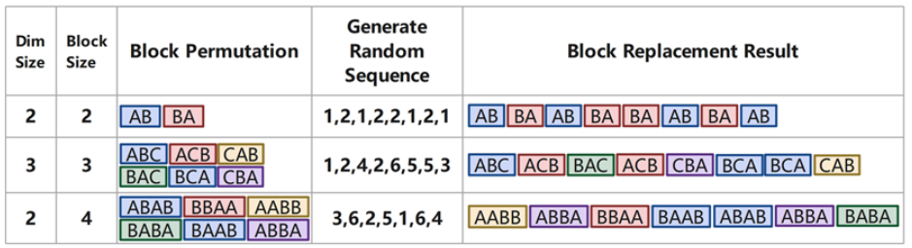
MS Randomization: Intra-Batch ⁴
Block Randomization Algorithm
Dimension (dim) size set as total number of sample groups (prognostic factor from Inter-batch)
Example: 4 dimensions = Batch 1, Batch 2, Batch 3, Batch 4
The size of the sample “block” is selected as a multiple of the dim size
Block size for 2 dimensions = 2, 4, 6 etc.
Minimum Recommended block size = 2*∑(tx ratio parts)
Example: 2 treatments in 1:1 ratio = 2(1+1) = Minimum block: 4
Write out all possible “block” combinations of samples that can be placed in the assigned block size & number
Generate random number sequence using range of 1 – number of combinations
Example: Range_{(dim = 2, block = 4)} = (1,6) | sequence: 1,5,2,2,3,6,4,5,5
Populate sequence using combination blocks as listed in the random sequence from step 4
Figure 2: Visual representation of block randomization of samples from treatment groups A and B ⁴
Goals:
Reduces impact of machine drift over multiple sample runs
Allows for QC samples to be collected from the same wells each run, as content of wells randomized
Reduces impact of manual fatigue after repeated sample filling if no automated fill
Notes:
Smaller blocks are better
Blocks are used as randomization units

Slide 6
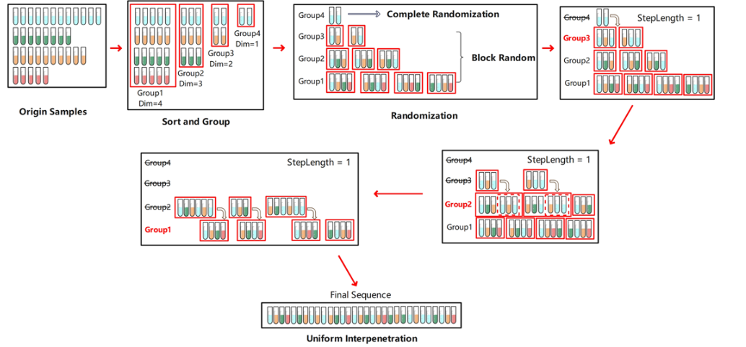
MS Randomization: Intra-Batch Uniform vs Non- Uniform Sample Distribution ⁴
Non-Uniformly Distributed Samples Adaptation
Randomized samples/blocks are interspersed into level below and re-randomized
Figures 3 : Randomization of non-uniformly distributed samples & uniformly distributed samples ⁴

Slide 7
Clinical Trial Randomization: Interactive Web Randomization Service (IWRS)
Centralized web applications allow for automated randomization into clinical trials
Allow for 24/7 emergency blind breaking
Ensures investigative team is blinded to treatment assignment
Allows for blocking & stratification programming for prognostic factors ²
Removes selection bias and prevents accidental bias
Allows for randomization into multiple treatment groups + placebo group
Allows for unequal allocation to treatment groups (3:1:1:1) ⁵
Common approaches:
Pocock-Simon’s Imbalance Score
The Symmetric KLD Index
Two-Way Minimization Method ⁵

Slide 8

IWRS: Pocock-Simon’s Imbalance Score ⁵
$$G_{i}= \sum_{j=1}^{J}{\sum_{m=r_{j}}{n_{ijm}}}$$
where the next patient entering has levels r₁ ,r₂, … , r_{j} on prognostic factors (j) 1, 2, … , J
Continuous prognosis factors are categorized to calculate treatment imbalance
Includes an initial simple randomization for a programmable number initial patients randomized before beginning imbalance calculation
Calculates marginal treatment total (G_{i}) if the new incoming patient is assigned to treatment group (i)
Relies on defined prognosis factors (J), levels of factor J (M_{j}), and treatment arm (i)
Totals for each treatment (i) are ranked to assign weights for randomization
Least G_{i} total given highest weight
Lower G_{i} total indicates the treatment that causes least imbalance between groups

Slide 9



IWRS: Systemic KLD Index ⁵
$$d_{i}=\frac{1}{2}\sum_{j=1}^{j′}{\left[\left\{{\left(\overline{x_{ij}} − \overline{x_{i^{′}j}}\right)}^{2}+{\left(V_{ij}+V_{i^{′}j}\right)}^{2}\right\}∗\left(\frac{1}{V_{ij}}+\frac{1}{V_{i^{′}j}}\right)−2j^{′}\right]} +$$
$$\sum_{j=j^{′}+1}^{J}{\sum_{m=1}^{M_{j}}{\left(p_{ijm}−p_{i^{′}jm}\right)∗\log{\frac{p_{ijm}}{p_{i^{′}jm}}}}}$$
$$where \overline{x_{ij}}=\frac{1}{n_{i}}\sum_{k=1}^{n_{i}}{x_{ijk} } \\ and V_{ij}=\frac{1}{n_{i}−1}\sum_{k=1}^{n_{i}}{{\left(x_{ijk}− \overline{x_{ij}}\right)}^{2}}$$
Approach limited to two treatment arms
Includes an initial simple randomization for the first 4 patients
Assumes multivariate distribution of continuous prognosis factors but works with normal distributed continuous & categorical factors
Calculates difference in distribution of prognosis factors between 2 treatments i and i’ (d_{i})
Uses $\overline{x_{ij}}$ as mean of prognostic factor value for pts in treatment i with prognostic factor j
Uses p_{ijm} as the proportion of subjects assigned to level m of prognostic factor j
Relies on defined prognosis factors (J), levels of factor J (M_{j}), and treatment arm (i)
Compares treatment arms with each other and with placebo to calculate d_{i} values
d_{i tx1 vs tx2} , d_{i tx2 vs tx1} , d_{i tx1 vs placebo} , d_{i placebo vs tx1} , d_{i tx2 vs placebo} , & d_{i placebo vs tx2}
Totals for each treatment (i) are ranked to assign weights for randomization
Least d_{i} total given highest weight
Lower d_{i} total indicates the treatment that causes least imbalance between groups
Notes:
Kullback-Leibler Divergence

Slide 10


IWRS: Two-Way Minimization ⁵
Imbalance in total number of subjects:
Imbalance in distribution of prognostic factors:
$$D= \sum_{j=1}^{J}{\left(\frac{\sum_{m=1}^{M_{j}}{\left|p_{Τjm} −p_{Cjm}\right|}}{M_{j}}\right)}$$
$$δ=\left|η_{Τ}− η_{C}\right|$$
Approach limited to two treatment arms
Includes an initial simple randomization until 1 subject is randomized to each group
Calculates both imbalance in total subject number and in distribution of prognostic factors
Uses n_{T} as total allocated to treatment & n_{C} as total allocated to control (placebo)
Uses p_{Tjm} as proportion in treatment with prognostic factors j at level m & p_{Cjm} as proportion in control with prognostic factors j at level m (placebo)
Calculate probability the new patient is allocated to minimize imbalance in patient number (P), and the probability the patient is allocated to minimize prognostic factor distribution (1-P)
P calculated using P = 1-0.95^{𝛿}

Slide 11
Mendelian Randomization ¹
Uses natural genetic variation to measure impact of modifying certain protein / biological function on a disease outcome of interest
Mimics experimental study without actual experimental intervention
Ex: Stratify observational coronary arterial disease (CAD) study by IL6R gene mutations to determine impact of reduced IL-6 signaling on occurrence of CAD
Commonly used as randomized blocking within randomized clinical trial population
Randomization technically completed by participants’ genome but requires genomic sequencing to complete randomization & use for future blocking
Relies on randomization techniques for DNA extraction & sequencing machines (1st section)
Can be used for blocking by IWRS systems in clinical trials (2nd section)
Key Assumptions:
Selected genetic variants (proxies) are strongly associated with the exposure of interest
No confounding by environmental variables OR nearby genetic signals
The association between the genetic variants and the outcome of interest is not explained by pathways outside of the exposure of interest

Slide 12
MR: Creation of Genetic Proxy ¹
Preliminary genome sequencing
Identifies possible genetic variants for gene of interest
Essentially measuring population variance in gene sequence
Identification and sampling of clinical phenotypes
Gene expression or protein expression levels in target tissue
Molecular phenotypes / blood biomarkers
Disease risk factors or Disease outcomes
Analysis of clinical phenotype by genetic variant
Determine if different genotypes are producing significantly different outcomes
Validation of genetic proxy for use
Clinical trials are conducted to verify the findings
Commonly measured with F test
protein quantitative trait loci (pQTLs)

Slide 13
MR: Utilization of the Mendelian Randomization ¹
Once validated, MR can be utilized for blocking in Phase III clinical trials
Allows for sub-population insights
Pseudo-randomization through blocking by genotype
Provides insight into power considerations if proxy identifies multiple potential clinical outcomes
Ex: if both stroke and CAD are flagged as outcomes of IL-6 signaling inhibitions, combining CAD and stroke into single clinical outcome group can increase statistical power
Rationale for use:
Inheritance of genetic variants is not confounded by environmental variables
Assignment of genetic code happens at gametogenesis and does not change even in the presence of disease/external conditions

Slide 14
Reference List
Daghlas I, Gill D. Mendelian randomization as a tool to inform drug development using human genetics. Cambridge Prisms: Precision Medicine. 2023;1:1-12. doi:10.1017/pcm.2023.5
Jatinder Singh. Randomization and online databases for clinical trials. Journal of Pharmacology & Pharmacotherapeutics. 2014;5(2):173-174. doi:10.4103/0976-500X.130155
Jiang F, Liu Q, Li Q, et al. Signal Drift in Liquid Chromatography Tandem Mass Spectrometry and Its Internal Standard Calibration Strategy for Quantitative Analysis. Analytical Chemistry. 2020/06/02 2020;92(11):7690-7698. doi:10.1021/acs.analchem.0c00633
Lu M, Jiang H, Wang R, An S, Wang J, Yu C. Injectiondesign: web service of plate design with optimized stratified block randomization for modern GC/LC-MS-based sample preparation. BMC Bioinformatics. 2023;24(1):1-16. doi:10.1186/s12859-023-05598-1
Xiao L, Huang Q, Yank V, Ma J. An Easily Accessible Web-Based Minimization Random Allocation System for Clinical Trials. Journal of Medical Internet Research. 2013;15(7):1. doi:10.2196/jmir.2392
Wei Z, Fang Y, Gosztyla ML, et al. A direct peptide reactivity assay using a high-throughput mass spectrometry screening platform for detection of skin sensitizers. Toxicology Letters. 2021/03/01/ 2021;338:67-77. doi:https://doi.org/10.1016/j.toxlet.2020.12.002

